Slide 1
Flood Detection System
Gaurav Nehra : 20BCS9147
Aryan Sharma : 20BCS9233
Shivani Kumari : 20BCS7057
Moksh Mehan : 20BCS1228
Khushi Wadhwa : 20BCS1448

Slide 2
Introduction :
Floods are natural disasters with severe consequences, including loss of life, property damage, environmental harm, and health risks. Flood detection systems are crucial for early warnings, risk reduction, data collection, and disaster management.
As climate change intensifies, these systems become increasingly vital for the safety of flood-prone communities. Identifying the client's specific requirements and expectations is essential for developing an effective flood detection system.

Slide 3
Technology used :
Remote Sensing: Utilizes satellite imagery for comprehensive coverage and monitoring of flood-prone areas.
IoT Sensors: Deployed in key locations to collect real-time data on water levels, weather conditions, and other relevant parameters.
Data Analytics: Processes and analyzes the collected data to identify patterns, anomalies, and potential flood indicators.

Slide 4
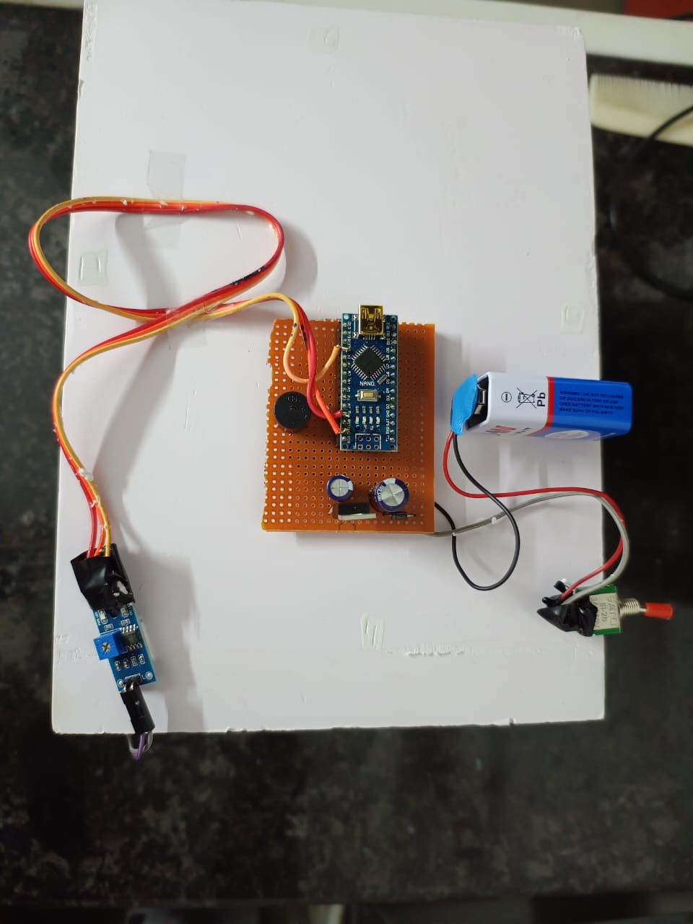
Components Used are :
Circuit Board
Capacitor
ESP32
Jumper Wires
Buzzer
Transistor
Battery
Relay Switch
LED Light
Diode

Slide 5
.
Circuit Board:
A circuit board, also known as a PCB (Printed Circuit Board), is a rigid or flexible board that contains electronic components and interconnects. It provides a platform for assembling and connecting electronic circuits, facilitating the flow of electrical signals between components.
Capacitor:
A capacitor is an electronic component that stores electrical energy in an electric field. It consists of two conductive plates separated by an insulating material (dielectric). Capacitors are used in circuits for energy storage, smoothing voltage fluctuations, and filtering.
ESP32:
The ESP32 is a versatile microcontroller and Wi-Fi/Bluetooth module, widely used in IoT (Internet of Things) applications. It features a dual-core processor, ample I/O pins, and built-in connectivity options, making it suitable for various embedded systems and wireless communication projects.
Jumper Wires:
Jumper wires are flexible wires with connectors at each end used to create electrical connections between components on a breadboard or circuit board. They are commonly used for prototyping and testing electronic circuits.

Slide 6
5. Buzzer:
A buzzer is an audible signaling device that produces sound when an electrical current is applied. It is commonly used to generate alarms, notifications, or sound signals in electronic circuits.
6. Transistor:
A transistor is a semiconductor device that amplifies or switches electronic signals. It consists of three layers of semiconductor material and can act as an electronic switch or an amplifier in various circuit applications.
7. Battery:
A battery is a portable energy storage device that converts chemical energy into electrical energy. It typically consists of one or more electrochemical cells and is used to power electronic devices by providing a voltage source.
8. Relay Switch:
A relay switch is an electromechanical device that uses an electromagnet to control the flow of electrical current. It typically has contacts that open or close in response to a control signal, allowing it to switch high-power circuits using a low-power input.

Slide 7
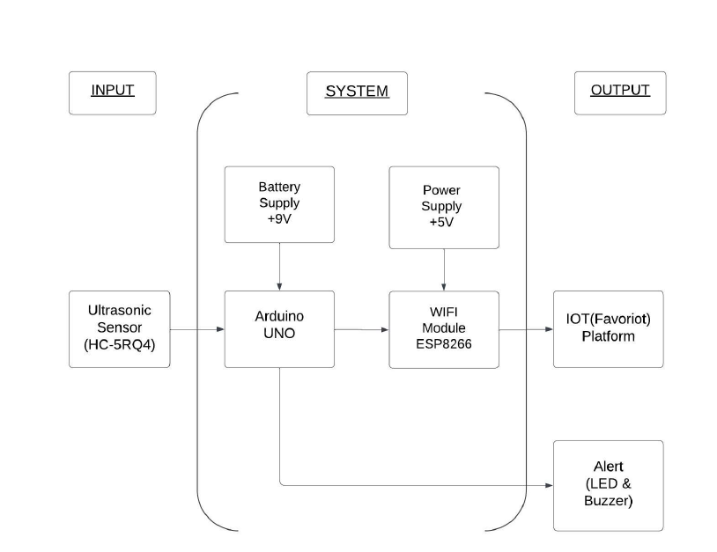
Flowchart :
.

Slide 8
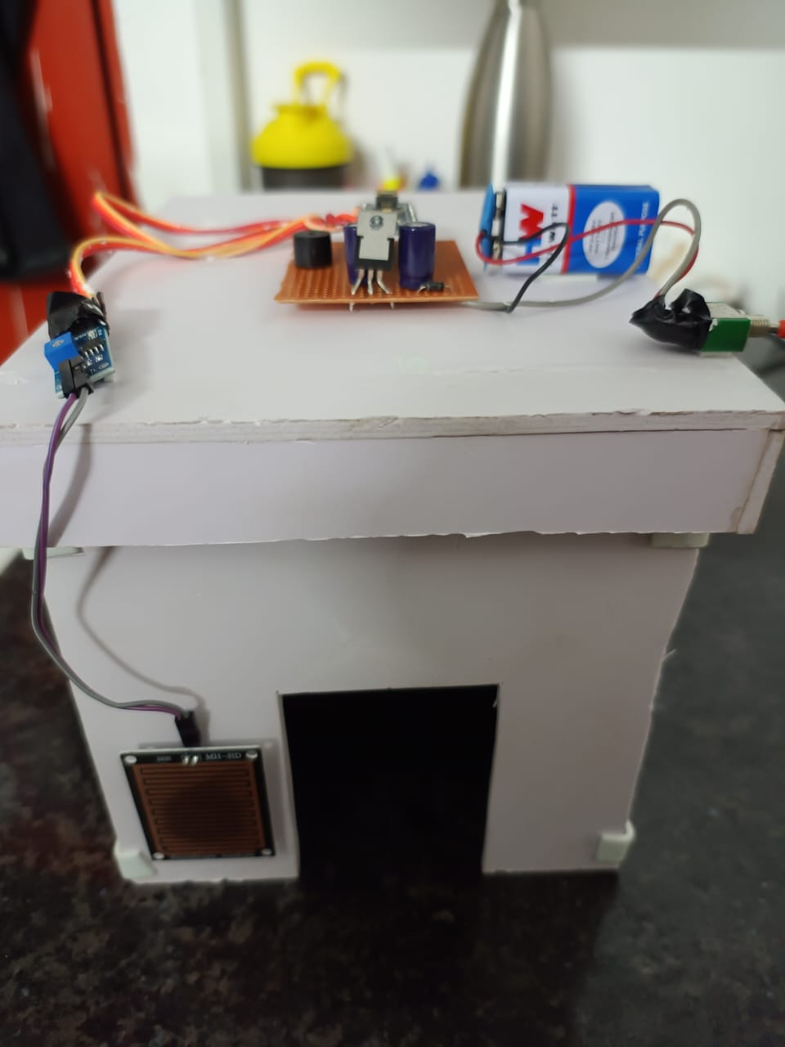
Result :

Slide 9
Conclusion :
In conclusion, the Flood Detection System aims to enhance early detection and disaster preparedness through sensor integration, real-time analysis, and effective communication. The system anticipates providing timely alerts via mechanisms like the Buzzer. However, potential deviations may arise from environmental factors, technical challenges, or unforeseen events. Thorough analyses will address root causes, involving recalibration, system updates, and continuous monitoring to ensure ongoing effectiveness and resilience. Adaptability and vigilance are essential for refining the system over time.

Slide 10
Future Scope :
Enhanced Sensor Technology:
Upgrade to sophisticated sensors for improved accuracy, durability, and environmental resistance.
Machine Learning Integration:
Incorporate machine learning algorithms to enhance flood risk assessments and reduce false alarms.
Community Engagement:
Involve the local community through feedback mechanisms, like mobile apps for real-time data reporting.
Integration with Emergency Response Systems:
Collaborate with local emergency response systems for efficient communication and coordination during floods.

Slide 11
Thank YOU
‘

